Slide 1
Week 3 Virtualization and Containerization
Dr Zhi Zhang

Slide 2
Overview
Operating System Concepts
Virtualization
Containerization

Slide 3
Operating System Concepts
Process scheduling
Virtual memory

Slide 4
What is a process?
A process is a program that is executed.
It is a basic unit of execution in an OS.

Slide 5
What is a process?
A process is a program that is executed
It is a basic unit of execution in an OS.
Process scheduling (time-sharing)
Each process is scheduled and executed within their time share.
The number of processes can be much larger than that of the CPUs.

Slide 6
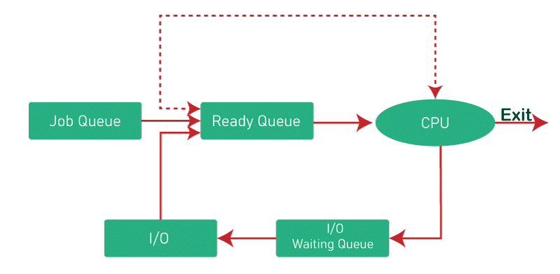
Process scheduling
https://byjus.com/gate/process-scheduling-in-operating-system-notes/

Slide 7
x86 Protection Rings (CPL)
CPU Privilege Level (CPL)
x86 has four protection levels (rings) /CPU privilege levels (CPLs).
ring 0 – “Kernel mode” (most privileged)
ring 3 – “User mode”
ring 1 & 2 – Other
Modern Oses such as Linux, Windows and MacOS only use ring 0 and ring 3.
“Kernel vs. user mode”

Slide 8
x86 Protection Rings (CPL)
OS
User Mode
User Processes
Kernel Mode
Process Scheduling
When CPU is in the user mode, it cannot execute sensitive/privileged instructions (e.g., HLT).

Slide 9
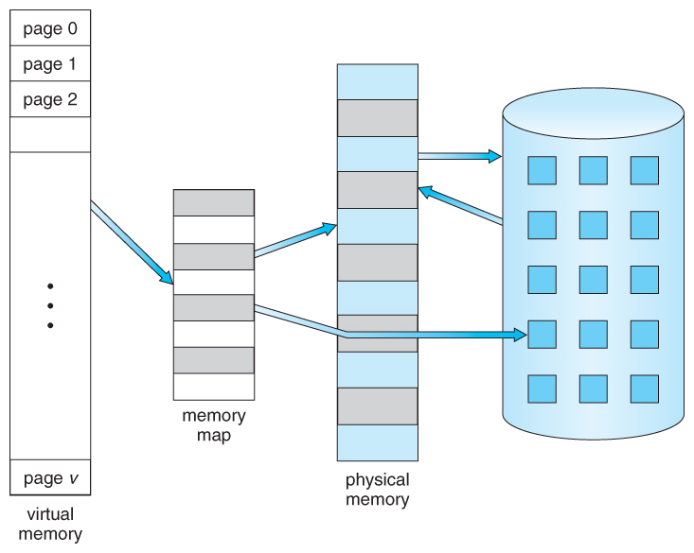
Virtual memory
Process A
Memory map
Physical memory
Disk
Virtual memory
https://www.cs.uic.edu/~jbell/CourseNotes/OperatingSystems/9_VirtualMemory.html

Slide 10
Paging/Swapping
Swapping
out
Process A
Swapping
in
paging
Memory map
Physical memory
(e.g., 2GB)
Disk
(e.g., 256GB)
Virtual memory
(e.g., 4GB)
https://www.cs.uic.edu/~jbell/CourseNotes/OperatingSystems/9_VirtualMemory.html

Slide 11
Virtual memory: 4GB
Virtual memory: 4GB
Physical memory: 2GB
?
Process A
Process B
Disk: 256GB

Slide 12
Virtual memory: 4GB
Virtual memory: 4GB
Physical memory: 2GB
Shared memory
Process A
Process B
Disk: 256GB

Slide 13
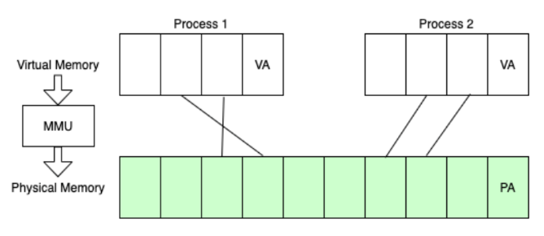
Memory map implementation
Page table:
In a modern OS, the OS uses a set of page tables to map virtual memory within a process to their corresponding physical memory in main memory.
VA refers to virtual address, pointing to a page-aligned memory location in a virtual page.
PA refers to physical address, pointing to a page-aligned memory location in a physical page.
https://www.alibabacloud.com/blog/a-tribute-to-hackers-the-way-to-explore-memory-virtualization_599058

Slide 14
Memory map implementation
Page table:
In a modern OS, the OS uses a set of page tables to map virtual memory within a process to their corresponding physical memory in main memory.
VA refers to virtual address, pointing to a page-aligned memory location in a virtual page.
PA refers to physical address, pointing to a page-aligned memory location in a physical page.
https://www.alibabacloud.com/blog/a-tribute-to-hackers-the-way-to-explore-memory-virtualization_599058

Slide 15
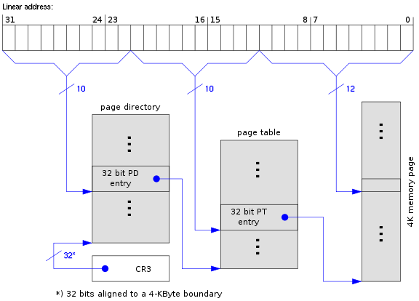
Memory map implementation: x86-32
Page table:
In a modern OS, the OS uses a set of page tables to map virtual memory within a process to their corresponding physical memory in main memory.
32-bit version of x86, known as IA-32 (Intel Architecture 32-bit), where 32-bit virtual/linear addresses are used.
https://www.cs.virginia.edu/~bjc8c/class/cs6456-s20/slides/01-intro.pptx

Slide 16
Memory map implementation: x86-32
Page table:
In a modern OS, the OS uses a set of page tables to map virtual memory within a process to their corresponding physical memory in main memory.
32-bit version of x86, known as IA-32 (Intel Architecture 32-bit), where 32-bit virtual/linear addresses are used.
2-level page tables
https://www.cs.virginia.edu/~bjc8c/class/cs6456-s20/slides/01-intro.pptx

Slide 17
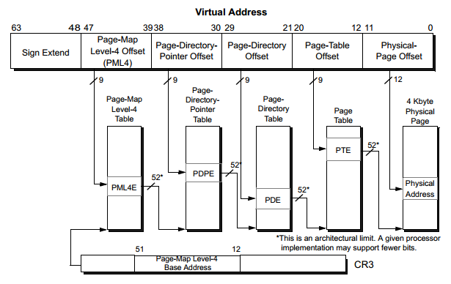
Memory map implementation: x86-64
https://superuser.com/questions/1740680/are-page-tables-under-utilized-in-x86-systems

Slide 18
What is virtualization?
Virtualization is the ability to run multiple operating systems on a single physical system and share the underlying hardware resources [1]
Allows one computer software (called Virtual Machine Monitor or Hypervisor) to provide the appearance of many computers (called virtual machines).
Goals:
Provide flexibility for users
Amortize hardware costs
Isolate completely separate users
[1] VMWare white paper, Virtualization Overview

Slide 19
Characteristics for Virtualizable Computer Architectures
First, the VMM is in complete control of all hardware resources, such as CPUs, memory, disk, etc.
Second, the VMM provides a virtualized hardware environment for a guest OS. The environment looks identical to its physical counterpart.
Last, the OS running in this environment shows minor decreases in performance compared to its execution in a bare-metal environment.

Slide 20
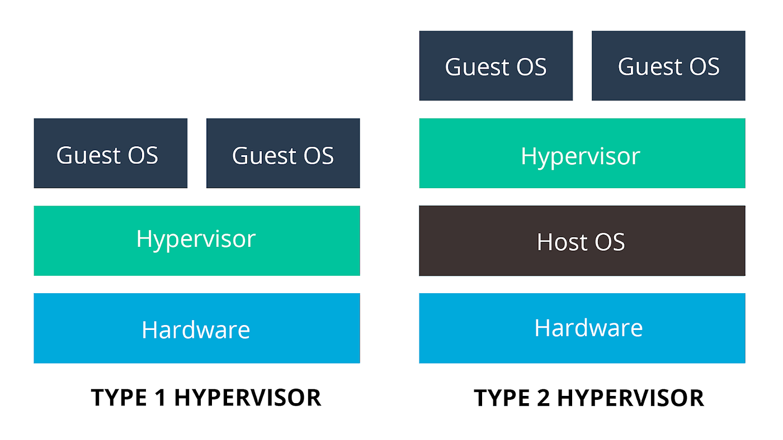
VMM Types
Bare-metal/Native Architecture
Hosted Architecture

Slide 21
VMM Types
Bare-metal/Native Architecture
Hosted Architecture
Examples: KVM, Xen, Hyper-V
Examples:?

Slide 22
VMM Types
Bare-metal/Native Architecture
Hosted Architecture
Examples: KVM, Xen, Hyper-V
Examples: VirtualBox, UTM, Vmware

Slide 23
VMM Types
Bare-Metal/Native Architecture
VMM or Hypervisor is installed directly on hardware as the most privileged software.
Acknowledged as preferred architecture for mainstream public clouds
Examples: KVM, Xen, Hyper-V
Hosted Architecture
Install as an application on an existing host OS, e.g., Windows, Linux, MacOS
Examples: Virtualbox, UTM, Vmware

Slide 24
VMM implementation on x86-64
Hardware support: Intel and AMD assist virtualization
Intel VT-x and AMD SVM: CPU and memory virtualization
Intel VT-d and AMD Vi: Device virtualization

Slide 25
CPU non-virtualization
Ring3
Ring2
Ring1
Ring0

Slide 26
CPU virtualization: Intel VT-x & AMD SVM
Host/VMX root mode
Guest/VMX non-root mode
Two VT-x operating modes
Less-privileged mode (guest or VMX non-root) for guest OSes
More-privileged mode (host or VMX root) for VMM
Ring3
Ring3
Ring2
Ring2
Ring1
Ring1
Ring0
Ring0

Slide 27
CPU virtualization: Intel VT-x & AMD SVM
Guest OS
Guest OS
VMX root mode
VMM runs directly on hardware
VMX non-root mode
Guest OS runs directly on hardware with a few exceptions
e.g., privileged/sensitive instructions.
Ring 3
Apps
Apps
VMX non-root
Ring 0
Kernel
Kernel
Ring 3
VM management utilities
VMX Root
Ring 0
Hypervisor core
VMM

Slide 28
CPU virtualization: Intel VT-x & AMD SVM
Guest OS
Guest OS
Two transitions
VM entry to non-root operation
VM exit to root operation
Ring 3
Apps
Apps
VMX non-root
Ring 0
Kernel
Kernel
VM Exit
VM Entry
VMX Root
Ring 3
VM management utilities
Ring 0
Hypervisor core
VMM

Slide 29
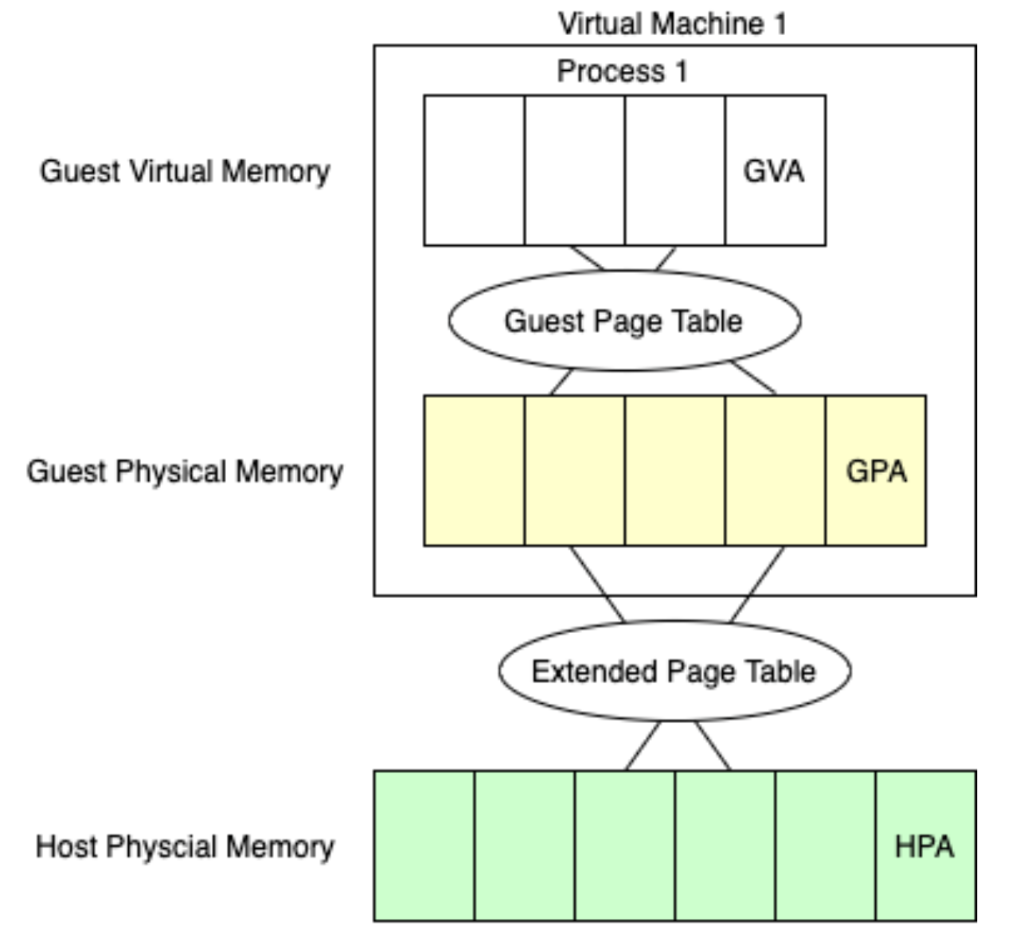
Memory virtualization: Intel EPT & AMD NPT
https://www.alibabacloud.com/blog/599058

Slide 30
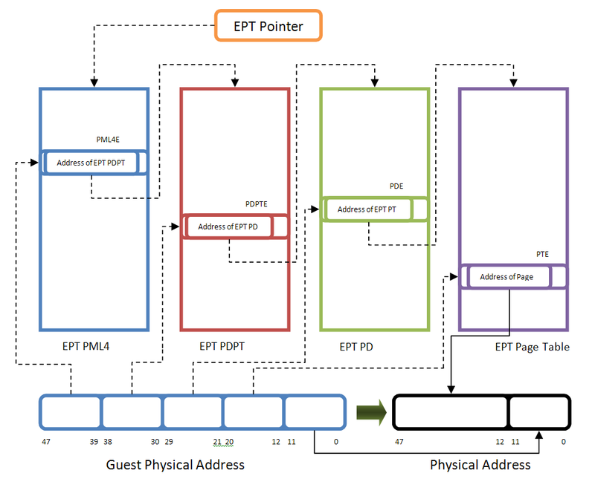
Memory virtualization: Intel EPT & AMD NPT
https://rayanfam.com/topics/hypervisor-from-scratch-part-4/#hardware-assisted-paging-extended-page-table

Slide 31
Containers
A container is a sandboxed process running on a host OS that is isolated from all other processes running on that host OS [2]
A container image is a stand-alone and executable software package (including software dependencies, binaries, etc) that contains everything needed to run a user application.
A container is a runnable instance of the image.
[2] https://docs.docker.com/get-started/

Slide 32

Containers
Container
VM
https://www.weave.works/blog/a-practical-guide-to-choosing-between-docker-containers-and-vms

Slide 33
Containerization vs. Virtualization
Granularity
Containers are an abstraction of the process layer and VMs are a simulation of the hardware layer.
Overhead
Required resources: containers are created to run one application and VMs support a whole OS.
Efficiency: containers are launched to run an application. VMs need to boot up an entire OS.
Security/Isolation
Containers are isolated from each other at the process level. VMs are isolated at the OS level.

Slide 34
Backbones of containers
namespaces
cgroups
copy-on-write filesystem

Slide 35
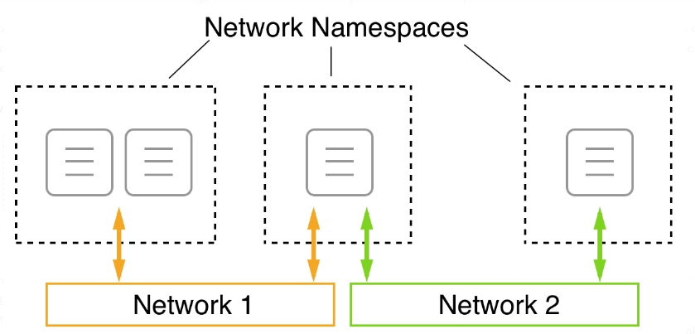
namespaces: limits what a container can see
Provide containers with their own view of system resources (e.g., network)
container
https://subscription.packtpub.com/book/cloud-and-networking/9781838827472/13/ch13lvl1sec97/running-in-an-existing-network-namespace

Slide 36
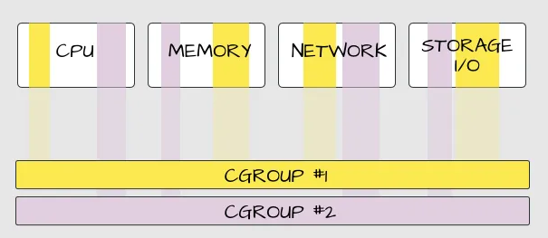
cgroups: limits how much a container can use
Control Groups: manage resource usage and limits for processes within a container.

Slide 37
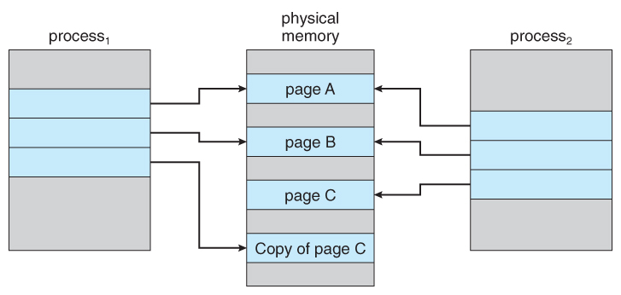
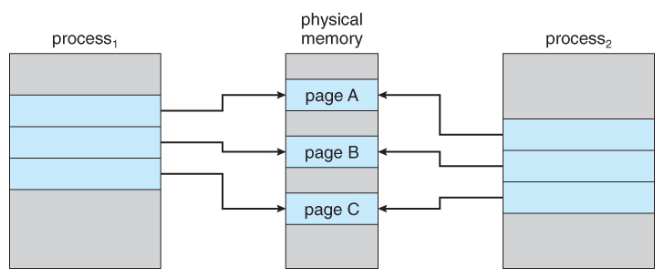
copy-on-write filesystem: lightweight container
Allow containers to share read-only underlying OS files. If a container write-access a file, a copy is created and updated accordingly.
Which process modified page C?
https://www.cs.uic.edu/~jbell/CourseNotes/OperatingSystems/9_VirtualMemory.html

Slide 38
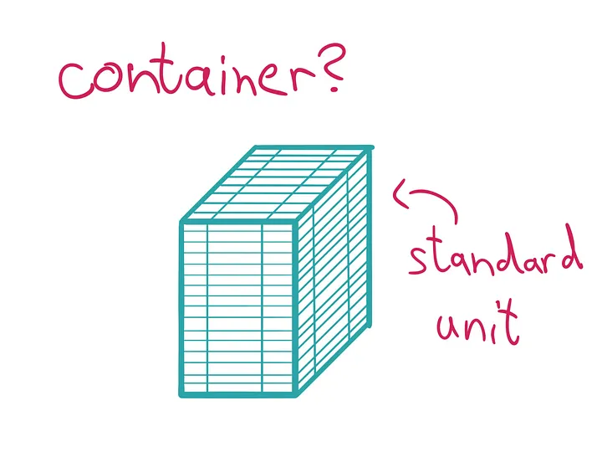
Docker container
Docker provides an interface on top of the techniques
Popularized containers (a standard unit of software)
https://medium.com/@saschagrunert/demystifying-containers-part-i-kernel-space-2c53d6979504

Slide 39
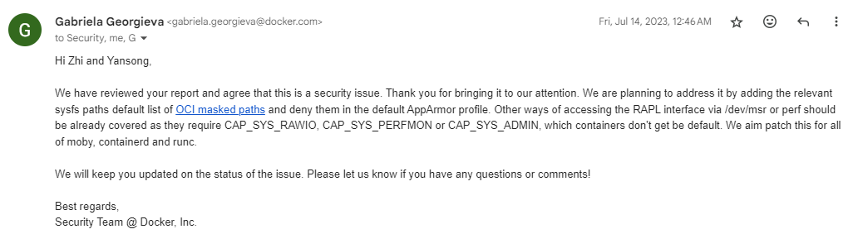
Docker container

Slide 40
Docker cheatsheet
docker run – Runs a command in a new container.
docker start – Starts one or more stopped containers
docker stop – Stops one or more running containers
docker build – Builds an image form a Docker file
docker pull – Pulls an image or a repository from a registry
docker push – Pushes an image or a repository to a registry
docker export – Exports a container’s filesystem as a tar archive
docker exec – Runs a command in a run-time container
docker search – Searches the Docker Hub for images
docker attach – Attaches to a running container
docker commit – Creates a new image from a container’s changes

Slide 41
Practice Questions
[7 marks] Q1: Describe what virtualization is. Describe three types of virtualization (Language, Operating System and Hardware) and their respective attribute.

Slide 42
Practice Questions
[7 marks] Q1: Describe what virtualization is. Describe three types of virtualization (Language, Operating System and Hardware) and their respective attribute.
[1 mark] Virtualization is a technology that allows multiple virtual instances of resources (e.g., operating systems) to run on a single physical machine.
[2 marks] Language virtualization:
[2 marks] Operating system virtualization:
[2 marks] Hardware virtualization:

Slide 43
Practice Questions
[7 marks] Q1: Describe what virtualization is. Describe three types of virtualization (Language, Operating System and Hardware) and their respective attribute.
[1 mark] Virtualization is a technology that allows multiple virtual instances of resources (e.g., operating systems) to run on a single physical machine.
[2 marks] Language virtualization: provides a virtual runtime environment (e.g., JVM) that allows code written in a specific programming language (e.g., Java) to execute.
Cross-OS: code can be executed in a virtual runtime environment across different OSes without modification.
[2 marks] Operating system virtualization:
[2 marks] Hardware virtualization:

Slide 44
Practice Questions
[7 marks] Q1: Describe what virtualization is. Describe three types of virtualization (Language, Operating System and Hardware) and their respective attribute.
[1 mark] Virtualization is a technology that allows multiple virtual instances of resources (e.g., operating systems) to run on a single physical machine.
[2 marks] Language virtualization: provides a virtual runtime environment (e.g., JVM) that allows code written in a specific programming language (e.g., Java) to execute.
Cross-OS: code can be executed in a virtual runtime environment across different OSes without modification.
[2 marks] Operating system virtualization: allows multiple user-space instances (e.g., docker containers) within a single operating-system kernel (e.g., Linux kernel).
Limited Isolation: instances share the host OS kernel, which means a vulnerability in the kernel could affect all instances.
[2 marks] Hardware virtualization:

Slide 45
Practice Questions
[7 marks] Q1: Describe what virtualization is. Describe three types of virtualization (Language, Operating System and Hardware) and their respective attribute.
[1 mark] Virtualization is a technology that allows multiple virtual instances of resources (e.g., operating systems) to run on a single physical machine.
[2 marks] Language virtualization: provides a virtual runtime environment (e.g., JVM) that allows code written in a specific programming language (e.g., Java) to execute.
Cross-OS: code can be executed in a runtime environment across OSes without modification.
[2 marks] Operating system virtualization: allows multiple user-space instances (e.g., docker containers) within a single operating-system kernel (e.g., Linux kernel).
Limited Isolation: instances share the host OS kernel, which means a vulnerability in the kernel could affect all instances.
[2 marks] Hardware virtualization: creates multiple virtual machines sharing a single physical server.
VM Snapshots: allows saving the current state of a VM
Live VM Migration: enables moving runtime VMs between physical hosts seamlessly.

